Slide 1
Nfinity Games Portal
Suggestions for Portal

Slide 2
Nfinity Games
Suggestions for Portal
Achievements Page
Clan & Guild Page
Web Browser Market System

Slide 3
Nfinity Games Portal
1. Achievements Page

Slide 4
1. Achievements Page
«Achievement System» can be upgraded on Portal User profile Accounts.
«Achievements» will be related only «Portal Activities».
Here are the example for Achievements
«Early Hours» (10 Points)
Login the Portal time between 06:00AM~06:30AM
«Friendly Fire» (10 Points)
Invite 10 Friend to Portal
«Elder» (20 Points)
Login the portal on First Day!
«Celebrate 2!» (30 Points)
Loging the portal with your account on 2nd year anniversary.
«Say Cheese» (10 Points)
Upload a profile picture to your Portal account.
«I am here!» (10 Points)
Spend 1.000 hours while you are logged in portal
«I was here!» (20 Points)
Spend 3.000 hours while you are logged in portal
«I will be here!» (30 Points)
Spend 10.000 hours while you are logged in portal

Slide 5
1. Achievements Page
All achievements will has special Points. Users can proof their reputations by that points also.
For portal activity, events can be prepared related portal achievement points.
«If you have 1.000 Portal Points, you will get 1 Day Cheytac on Point Blank!»
Achievement Points
460
User Profile
«Early Hours» has been earned! (10 Points)
«Elder» has been earned! (20 Points)
«I will be here!» has been earned! (30 Points)
In-game Achievement Sample from World of Warcraft:
http://eu.battle.net/wow/en/character/twisting-nether/Elika/achievement#92

Slide 6
Nfinity Games Portal
2. Clan & Guild Page

Slide 7
2. Clan & Guild Page
Special Profiles can be created for Point Blank Clans or Troy Guilds.
It is too hard to use game database for web site such as Portal. But we can support the users for their community page.
Lots of community page is still exist. But hard-core game players using them such as WoW, Guild Wars 2, SWTOR etc.
http://www.twistedestiny.net/
www.enjin.com
Maybe the web sites are very complicated above, but simple ones can be created.
How can a player create the Guild&Clan Page?
Only Clan Masters can request a page
He/She have to make a request from Portal Management
After request has been approved, a special blog account can be managed by Clan Master. (Clan pages will be similar with user profile account)
Benefits
That function will support to MMORPG community
FPS clans will be supported also. This is very important for E-Sports.

Slide 8
Nfinity Games Portal
3. Web Browser Market

Slide 9
3. Web Browser Market System
Special or Discounted items can be sold by Portal Web Page.
With that, users can «Quick Charge» and «Quick Purchase».
If event related Web Market has been made, community will keep the Portal as well.
That system only can be used by Portal.
Item content should be editable by Nfinity Games Management.

Slide 10
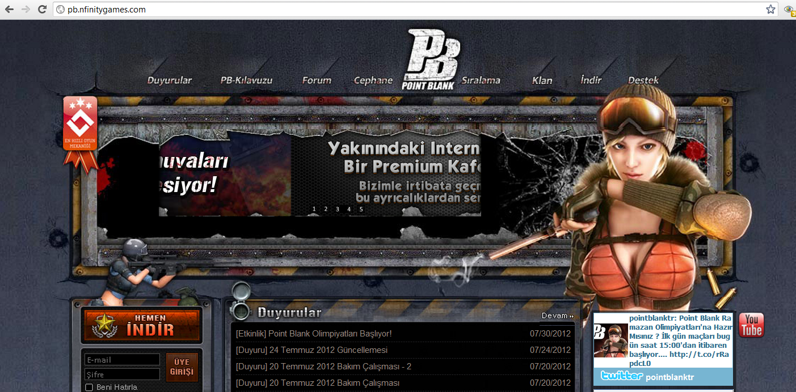
3. Web Browser Market System
CheyTac M200 (30 Days)
%20 Discount : 2.000 NG
Purchase!!
Troy X Item
%20 Discount : 1.000 NG
Purchase!!

